Slide 1
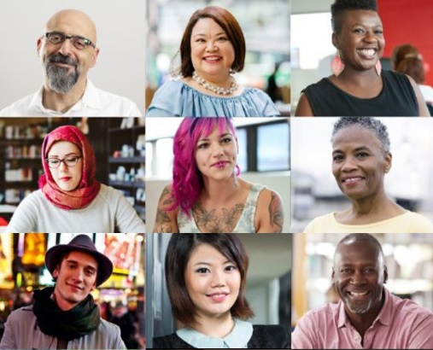
Changing the Equation for Diversity & Inclusion
Sabrina Stoffregen
Diversity & Inclusion
Cisco

Slide 2
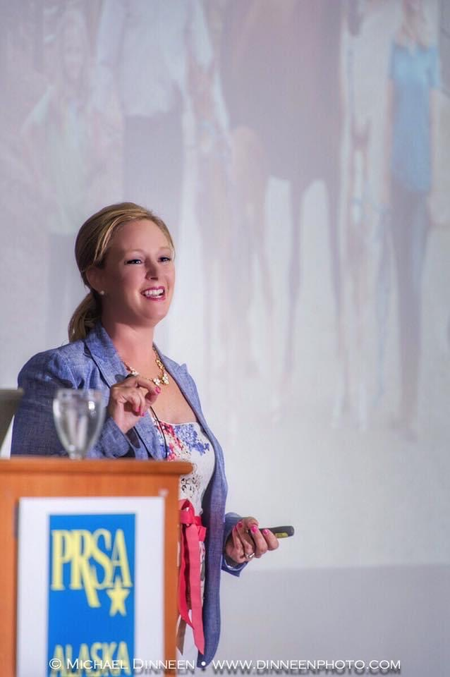
Changing the Equation for Diversity & Inclusion
What we’ll discuss…
Diversity & Inclusion journey and transformational shift
Building an inclusive employee experience and culture
The power of proximity to create dialog and shared meaning
Harnessing the power of connection and community
Measuring impact and continued growth
Take action. Start today.
Notes:
What we’ll discuss…
Diversity & Inclusion journey ad transformational shift
Inclusive employee experience and culture
The power of proximity to create dialogue and shared meaning
Harness the power of connection and community
Impact of engagement and continued growth
Take action. Start today.

Slide 3
1
Diversity & Inclusion journey and transformational shift
“
“
Inclusion is the power of people—connected
Notes:
At Cisco, we see inclusion as a bridge—a way to connect diverse perspectives. To spark new ideas, explore new possibilities, tap into the power of digital transformation, and inspire innovation.

Slide 4
Transformational Shift in How We View D&I
Inclusion and Collaboration
Transformational Shift
Full spectrum participation enabled by collaboration technology
Diversity
and Inclusion
Existing Best Practices
The number of diverse people and how they feel
Cisco Collaboration Technology
Diversity
Classic Approach
Government compliance – the number of diverse people
Exponential Value Creation
Full Spectrum Participation
Full Spectrum Participation
Notes:
At Cisco, we’ve made a transformational shift in how we view diversity and inclusion.
For the past several years, the discipline of diversity and inclusion has been in a state of transition.
In the first transition, diversity was focused on government compliance – counting people.
The second transition was focused on how employees feel and creating an environment where they had a sense of belonging and could thrive.
The third transition, which we are in now, focuses on leveraging our collaboration technology to enable the full spectrum of diversity to participate in the business. Full spectrum participation is where we have the biggest opportunity to create exponential value for Cisco by enabling faster and better business outcomes.
Diversity is foundational to our value proposition. The value of diversity is amplified and accelerated through inclusion and collaboration.

Slide 5

Inclusion is the power of people- connected
Diversity, inclusion, collaboration are the bridge to connect diverse perspectives. Spark new ideas. Challenge the status quo. Inspire innovation. And unleash the full power and potential of our people.
Notes:
Inclusion is the power of people—connected
Cisco sees inclusion and diversity as essential to fueling what we call the power of connection.
At Cisco, Inclusion and Collaboration (I&C) are fundamental to who we are - and where we are going. We see inclusion as a bridge - a way to connect diverse perspectives, spark new ideas, explore new possibilities, and inspire innovation. True collaboration - true leadership - and true success are possible only when we value and embrace a full spectrum of diversity - gender, generation, race, ethnicity, orientation, ability, nationality, religion, veteran status, background, culture, experience, strengths, and perspectives.

Slide 6

“Diversity, inclusion and community engagement are foundational to our culture, our ability to attract, hire and retain the best and brightest people, and what makes Cisco one of the best places to work in the world.”
Chuck Robbins
Chairman and CEO
Notes:
Diversity and inclusion starts at the top.
Inclusion & Collaboration is delivering on the purpose to power an inclusive future for all.
We are fortunate to be led by a CEO who is extremely committed to a diverse workforce and inclusive culture.
To quote Chuck:
“Diversity, inclusion and community engagement are foundational to our culture, our ability to attract, hire and retain the best and brightest people, and what makes Cisco one of the best places to work in the world.”

Slide 7

The value of diversity and inclusion
Inclusive teams make better business decisions up to
87%
of the time.
Source: Cloverpop, 2017
A diverse workforce and inclusive culture positively impact decision-making, innovation and financial performance.
Companies with an inclusive culture are
6X more likely to
be innovative.
Source: Deloitte, 2018
75% of businesses with diverse frontline decision-making teams will exceed their financial targets through 2022.
Source: Gartner, 2019
Notes:
Diversity and inclusion have never been more important or relevant in business than they are today.
A diverse workforce and inclusive culture positively impacts decision-making, innovation and financial performance.
Here are a few of many stats that support the value of diversity and inclusion:
Inclusive teams make better business decisions up to 87% of the time.
Companies with an inclusive culture are 6X more likely to be innovative.
75% of businesses with diverse frontline decision-making teams will exceed their financial targets through 2022.
---------------------------------------------------------------------------------------
Sources:
https://www.cloverpop.com/hubfs/Whitepapers/Cloverpop_Hacking_Diversity_Inclusive_Decision_Making_White_Paper.pdf
https://www2.deloitte.com/insights/us/en/deloitte-review/issue-22/diversity-and-inclusion-at-work-eight-powerful-truths.html
https://www.gartner.com/en/newsroom/press-releases/2019-02-11-gartner-predicts-by-2021--cios-will-be-as-responsible

Slide 8
2
Culture and Collaboration
“
“
Build an inclusive employee experience and collaborative company culture.
Notes:
Build an inclusive employee experience and collaborative company culture

Slide 9

Cisco is committed to
Inclusive Culture – where our employees feel welcomed, valued, respected, accepted and heard, and are enabled by our technology to fully participate in the business.
Full Spectrum Diversity – inclusive of gender, ethnicity, race, orientation, age, ability, veteran status, religion, culture, background, experience, strengths and perspectives.
Notes:
Our definition of diversity and inclusion is expansive, intersectional and continually evolving.
We are committed to:
Full spectrum diversity - inclusive of gender, ethnicity, race, orientation, age, ability, veteran status, religion, culture, background, experience, strengths and perspectives; and
An inclusive culture where our employees feel welcomed, valued, respected, accepted and heard, and are enabled by our technology to fully participate in the business.

Slide 10

Fostering a
Conscious Culture
Diverse and inclusive culture
Built on fairness, dignity and respect
Free from bias, discrimination and negative behavior
Where our people:
  Actively monitor, protect and care for each other and our environment, and
  Are accountable, empowered and expected to speak up about any actions that don’t align to our values
Notes:
As we look ahead to some of the biggest initiatives we’re focused on - one is Fostering a Conscious Culture.
Cisco has recently embarked on a journey to build a Conscious Culture – which we define as:
A diverse and inclusive culture
Built on fairness, dignity and respect
Free from bias, discrimination and negative behavior
Where our employees:
Actively monitor, protect, and care for each other and our work environment, and
Are accountable, empowered and expected to speak up about any actions that don’t align to our values
As part of our Conscious Culture, we are being more transparent about our Employee Relations data. We share the number and types of cases and the outcomes and resolutions with our Board, ELT and employees on a regular basis.
We believe everyone at Cisco – employees, contractors, customers, partners, suppliers and investors - has a shared responsibility for fostering a conscious culture where we can all be our best selves, feel safe and thrive.

Slide 11

The Multiplier Effect Pledge
Challenges leaders at all levels to pledge to sponsor an extraordinary diverse person for career advancement and challenge their peers to do the same. We’ve built a digitized platform for people to take the pledge, download sponsorship resources and share their sponsorship stories.
www.multiplydiversity.com
Pledge founded in
2017
at Mobile World Congress
People with sponsors
23%
more likely to advance in their careers
Individuals from
300+
companies have taken the pledge
100%
of Cisco’s executive leadership team has taken the pledge
Notes:
The Multiplier Effect Pledge leverages the power of sponsorship to accelerate the pipeline of diverse talent in tech.
The pledge challenges leaders at all levels to make a personal commitment to sponsor at least one extraordinary diverse person for career advancement and challenge their peers to do the same.
Cisco has built a digitized sponsorship platform for people to take the pledge, download sponsorship resources, and share their sponsorship stories. www.multiplydiversity.com/
Key highlights:
The pledge was founded in 2017 at Mobile World Congress – our CEO Chuck Robbins was the first leader to take the pledge.
Research shows people with sponsors are 23% more likely to advance in their careers.
Individuals from more than 300 companies have taken the pledge.
100% of Cisco’s executive leadership team has taken the pledge and this number continues to grow.

Slide 12

Pay Parity
Cisco has always been committed to paying our people fairly and equitably.
We’ve built an innovative and inclusive framework to review and test the overall health of our compensation. Our global analyses have revealed a healthy compensation system overall. Where we find minor gaps, we continue to fix them.
1.0%
of global employee population reflected minor disparities*
.04%
Percentage of global payroll—a small fraction—
to address minor gaps*
Member Employers for Pay Equity Consortium committed to closing the pay gap
Founding signer
White House Equal Pay Pledge, Parity.org pledge and California Equal Pay Pledge
*FY19 data
Notes:
Cisco has always been committed to paying our people fairly and equitably.
We’ve built an innovative and inclusive framework to review and test the overall health of our compensation.
Our global analyses have revealed a healthy compensation system overall. Where we find minor gaps, we continue to fix them.
Key highlights:
In FY19, we identified minor disparities within approximately 1.0 percent of our global employee population. We have given pay adjustments in an effort to close those minor gaps.
The funds required to address these gaps represent .04% of global payroll—a small fraction.
Cisco is a member of the Employers for Pay Equity Consortium – employers that believe business can play a critical role in eliminating the national gender pay gap. Member companies have teamed to leverage their collective experiences to create a shared set of Principles to Pay Equity.
Cisco is taking a leadership role in this important topic. We are a founding signer of the White House Equal Pay Pledge, Parity.org pledge and California Equal Pay Pledge.

Slide 13
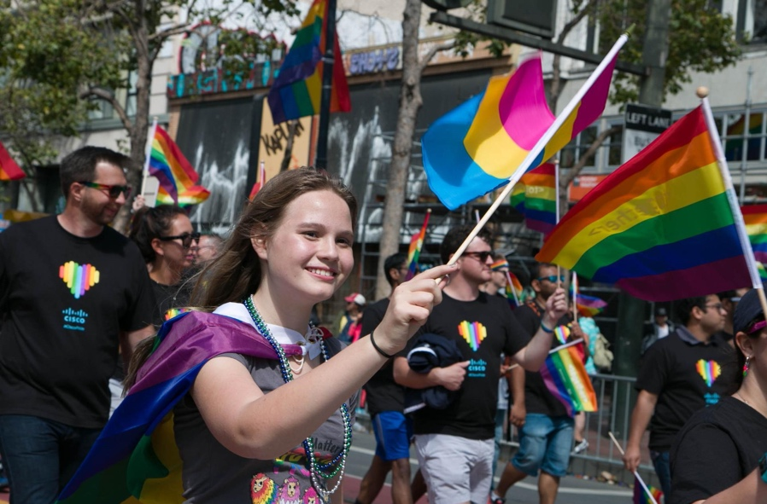
I&C Community
Cisco’s Inclusion and Collaboration (I&C) Community increases inclusion by providing safe spaces where employees feel comfortable bringing their whole selves to work. Our digitized global platform–ICC Connect–enables diverse groups to connect, collaborate and innovate with team members around the world who share their interests and passions.
29K
active members
73
countries
243
chapters
27
Employee Resource Organizations
and Networks
Notes:
Cisco’s I&C Community increases inclusion by providing safe spaces where employees feel comfortable bringing their whole selves to work.
Our I&C Community includes our Employee Resource Organizations (EROs), ICC Networks, Virtual Groups, I&C Ambassadors, and our flagship diversity experiences, such as the Women of Impact conference.
Our online global platform–ICC Connect–enables diverse groups to connect, collaborate and innovate with team members around the world that share their interests and passions.
The platform enables us to track participation and provides valuable data and insights, such as the correlation between people who are members of I&C Community and the likelihood of development, retention and promotion.
Key highlights:
More than 29,000 active members
73 countries
243 chapters
27 employee resource organizations and networks

Slide 14

I&C Solutions Portfolio
All our Inclusion & Collaboration solutions and partnerships have been specifically designed to address bias, encourage allyship, advance full-spectrum diversity, and promote empathy, belonging, and vulnerability.
Strategic Partnerships
Expand our ability to recognize extraordinary diverse talent and give our emerging leaders the capabilities, mentoring, and sponsorship, and insightful experiences they need to progress in their careers.
GlobeSmart
An online reference tool with detailed information on the business-related culture of more than 93 countries. GlobeSmart can help employees work more effectively with team members, customers, suppliers, and partners from diverse cultural background.
Next Generation Leaders
Create Next Generation Leaders transforms leadership development with managers and their diverse employees by embarking on a six-month journey to embrace differences, unlock talent, and foster disruptive thinking.
Bias Mitigation
Create an inclusive and conscious culture by mitigating bias in our people, leaders, processes, and employee experiences.
Courageous Conversations
Provided discussion guides on how to facilitate authentic conversations around sensitive topics, practice tools, and resources to promote on-going dialog.
Notes:
We are Proud to Partner with:
Conferences for Women (CFW)
Diversity Women Business Leadership Conference
Executive Leadership Council (ELC)
Hispanic IT Executive Council (HITEC)
Information Technology Senior Management Forum (ITSMF)
Lesbians Who Tech
MLT Career Advancement Program
Out and Equal Workplace Summit
Professional Business Women of California (PBWC) and Webinars
​​​​​​​Simmons Leadership Conference
YWCA

Slide 15
3
The Power of Proximity
“
“
Leverage dialogue and create shared meaning
Notes:
Dialogue has the potential to unify and increase awareness and understanding when employees seek shared meaning.

Slide 16
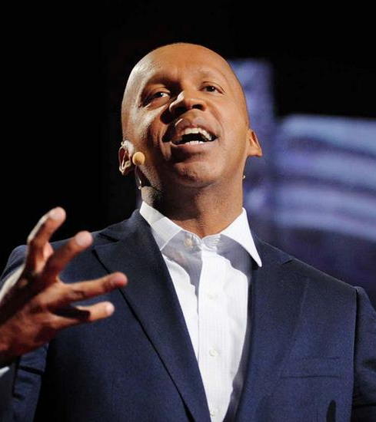
Get comfortable with being uncomfortable because that’s when learning happens.
Bryan Stevenson
Notes:
In an engaging and personal talk -- with cameo appearances from his grandmother and Rosa Parks -- human rights lawyer Bryan Stevenson shares some hard truths about America's justice system, starting with a massive imbalance along racial lines: a third of the country's black male population has been incarcerated at some point in their lives. These issues, which are wrapped up in America's unexamined history, are rarely talked about with this level of candor, insight and persuasiveness.

Slide 17
Conversations we’re having now
How can we leverage the power of proximity to create a culture of sponsorship
What is unconscious bias and how does it affect our behavior and decision making and subtle such as Micro-Inequities & Micro-Aggressions?
How do we build a diverse talent pipeline? What are we doing to hire, develop, and engage our talent?
How do we help facilitate conversations about allyship & advocacy?
Notes:
How do we build a diverse talent pipeline? What are we doing to hire, develop, and engage our talent?
How can we leverage the power of proximity to create a culture of sponsorship
How do we help facilitate conversations about allyship & advocacy?
What is unconscious bias and how does it affect our behavior and decision making and subtle such as Micro-Inequities & Micro-Aggressions?

Slide 18
4
Harness the power of connection and community
“
“
Dialogue is the oxygen of
employee engagement and inclusion.
Notes:
Dialogue is the oxygen of employee engagement and inclusion.

Slide 19
Communication Best Practices
Stories Resonate
Stories are the most powerful way you can make an emotional connection with your audience. How can you build a personalized storytelling platform that tie to the action you need to accomplish? Find your voice. Share your story.
Mindset Matters
Understanding audience mindset is critical to build relevancy. Why should they care? Asking for input is an easy way to engage your audience. What motivates them? How can you compel them to action?
Connection is Key
The goal is to create and facilitate dialogue, not to make a presentation. Two-way dialogue is the key. Build in time to listen. Humans are hard-wired for connection.
Simplify and Summarize
Use simple, memorable ways to package key concepts and then amplify your point with real-life examples. You win the hearts and minds of your audience through compelling storytelling not listing facts and figures.
Notes:
Page 19
Stories Resonate
Stories are the most powerful way you can make an emotional connection with your audience. How can you build a personalized storytelling platform that tie to the action you need to accomplish? Find your voice. Share your story.
Connection is Key
The goal is to create and facilitate dialogue, not to make a presentation. Two-way dialogue is the key. Build in time to listen. Humans are hard-wired for connection.
Mindset Matters
Understanding audience mindset is critical to build relevancy. Why should they care? Asking for input is an easy way to engage your audience. What motivates them? How can you compel them to action?
Simplify and Summarize
Use simple, memorable ways to package key concepts and then amplify your point with real-life examples. You win the hearts and minds of your audience through compelling storytelling not listing facts and figures.

Slide 20
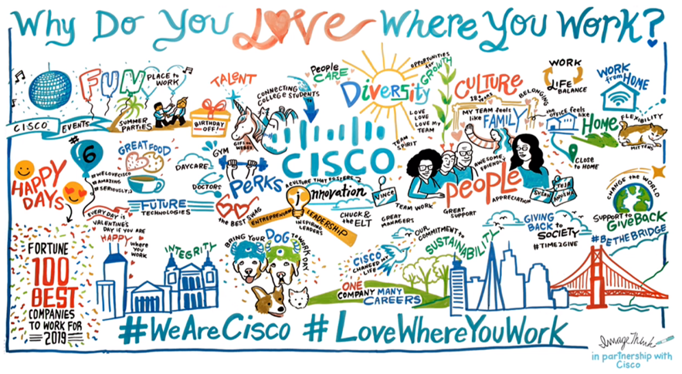
Stories Resonate

Slide 21
5
Measure impact and continued growth and learning
“
“
Accelerate, sustain, and institute change that drives continuous improvement

Slide 22


Inclusion and Collaboration Highlights
Overall Diversity
Employee Communities
Giving Back
Community Impact
73
448K
Most diverse Cisco since 1998
countries
Fortune ranked Cisco
employee
volunteer hours
243
$25.5M
chapters
#3
Best Workplaces
for Giving Back 2018
29,000+
donations to charities and matching gifts
active members
Best Workplaces for Diversity
Leadership Diversity
Global Workforce by Gender
U.S. Workforce by Ethnicity
Fortune ranked Cisco
62%
74%
#2
100 Best Workplaces for Diversity 2019
male
diversity on executive leadership team
26%
female
White/Caucasian
Asian
Hispanic/Latino
Black/African American
Two or More Races (Not Hispanic or Latino)
American Indian or Alaska Native
Native Hawaiian/Other Pacific Islander
52%
37%
5.6%
3.8%
1.3%
0.2%
0.2%
CEO Commitment
Pay Parity
550+
.04%
Cisco signed the CEO Action for Diversity & Inclusion™ Pledge along with 550+ other companies.
Our third global analysis resulted in an investment equal to .04% of global payroll to address gaps. When we find gaps, we fix them.
Source: Cisco Corporate Social Responsibility Report 2019
Notes:
While we have more work to do to achieve our diversity goals, we are extremely proud of our progress.
Here are a few highlights….

Slide 23


Additional Information
Inclusion Coaching Diversity, Inclusion, and Collaboration @ Cisco
www.cisco.com/c/en/us/about/inclusion-diversity.html
Resources
Bryan Stevenson, Equal Justice Initiative, Just Mercy
https://eji.org/
Sylvia Ann Hewlett, The Sponsor Effect
http://www.sylviaannhewlett.com/
Examples of workplace micro-aggressions
https://www.youtube.com/watch?v=XjgozDwAjqg
Guide to Allyship
https://guidetoallyship.com/#what-is-an-ally
Notes:
Equal Justice Initiative, founded in 1989 by Bryan Stevenson, a widely acclaimed public interest lawyer and bestselling author of Just Mercy, EJI is a private, 501(c)(3) nonprofit organization that provides legal representation to people who have been illegally convicted, unfairly sentenced, or abused in state jails and prisons. We challenge the death penalty and excessive punishment and we provide re-entry assistance to formerly incarcerated people.
EJI works with communities that have been marginalized by poverty and discouraged by unequal treatment. We are committed to changing the narrative about race in America.
Sylvia Ann Hewlett is an economist and the CEO of Hewlett Consulting Partners. She is also the founder and Chair Emeritus of the Center for Talent Innovation. In her scholarship and consultancy work Hewlett has focused on the “value of difference” and the challenges and opportunities faced by women, people of color, LGBT employees and other previously excluded groups. She has forged a signature style of enquiry which blends hard data and rigorous analysis with in-depth story-telling and concrete solutions. She is a member of the Council on Foreign Relations and the Century Association.
Hewlett is the author of 17 Harvard Business Review articles and 16 critically acclaimed books, including When the Bough Breaks (winner of a Robert F. Kennedy Memorial Book Award); Off- Ramps and On-Ramps; Winning the War for Talent in Emerging Markets; Forget a Mentor, Find a Sponsor (an Audible best seller); Executive Presence (an Amazon “Best Book of the Month,”), and The Sponsor Effect (Financial Times “Business Book Of The Month.”) She has been recognized as the Most Influential International Thinker by HR magazine and honored by Google with its Global Diversity Award.

Slide 24

What steps could you take today to create a culture of sponsorship?
What conversations are you having now about unconscious bias?
How can you help facilitate conversations about allyship & advocacy?
Watch Bryan Stevenson’s TED talk
“We need to talk about an injustice”
Notes:
What you can do now? Where can you lean in? What are you willing to do differently?
I will do one thing today
How might you use your gifts and talents to help dismantle systemic racism?
Watch Bryan Stevensons Ted Talk, We need to talk about an injustice https://www.ted.com/talks/bryan_stevenson_we_need_to_talk_about_an_injustice?language=en
What steps could you take today to create a culture of sponsorship?
Assess where your company is at in the transformation shift in how they view D&I
Actively engage and partner with social justice organizations (Bryan Stevenson)
Make the business care about the value of diversity and inclusion
Define what Diversity and Inclusion means to you. What is your North Star?
Host/ moderate courageous conversatins
What does your talent pipeline look like? What is your strategy to hire, develop, and engage diverse talent?
What conversations are you having now about your talent pipeline? Unconscious bias, and the power of proximity
Attend a conference (e.g. ​​​​​​​Simmons Leadership Conference, Diversity Women Business Leadership Conference)

Slide 25
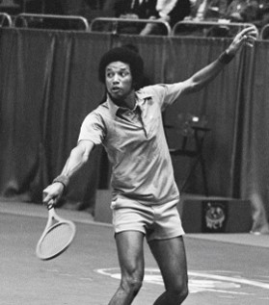
Start where you are.
Use what you have.
Do what you can.
~Arthur Ashe
“
”
Notes:
Arthur Robert Ashe Jr. was an American professional tennis player who won three Grand Slam singles titles. Ashe was the first black player selected to the United States Davis Cup team and the only black man ever to win the singles title at Wimbledon, the US Open, and the Australian Open. He retired in 1980.

Slide 26
Questions

