Slide 1
Anchorage Economic Development Corp.
Sean Carpenter and Natasha Price
Internal Publication– 1st Place

Slide 2
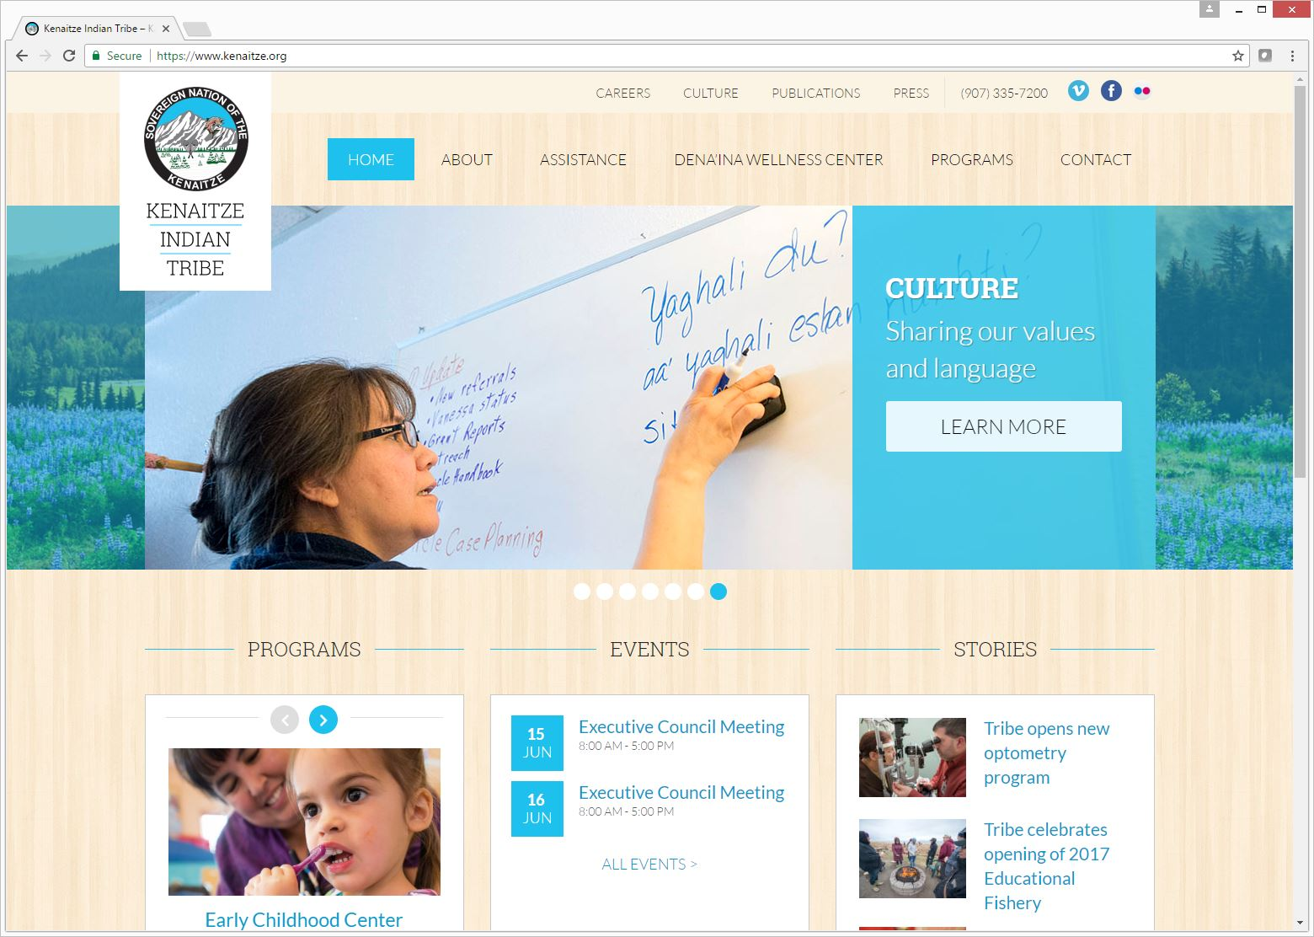
Kenaitze Indian Tribe and Sundog Media
M. Scott Moon, Wesley Remmer, Sundog Media
Website– 2nd Place

Slide 3
Saggio: POGO Mine 10th Anniversary
Lindsey Spinelli, Joshua Borough, Lorna Shaw, Jackie Bartz-Holbook
Events & Observances (More than 7 days)– 2nd Place

